Slide 1



Interview Preparation Chatbot
By Anirudha Joshi
Prompt Engineering and AI
Jul 15, 2024
Welcome to my final project presentation on the development of an interview preparation chatbot that utilizes LLM and RAG implementation. This innovative project aims to provide personalized interview preparation resources, utilize user inputs for tailored learning paths, and enhance user readiness for interviews. By combining AI and NLP advancements, we address real-world needs in career development.
by Anirudha Joshi

Slide 2

Introduction
1
Project Overview
Brief overview of the final project: Development of an interview preparation chatbot that utilizes LLM and RAG implementation.
2
Objectives and Goals
- Provide personalized interview preparation resources. - Utilize user inputs for tailored learning paths. - Enhance user readiness for interviews.
3
Importance and Relevance
This project combines AI and NLP advancements to address real-world needs in career development.

Slide 3
Project Description
Detailed Description
Specific Problem
Scope
An intelligent chatbot that helps users prepare for job interviews based on their role, time availability, daily commitment, and resume.
Lack of personalized and structured interview preparation resources.
Providing video resources, blogs tailored to individual needs.

Slide 4
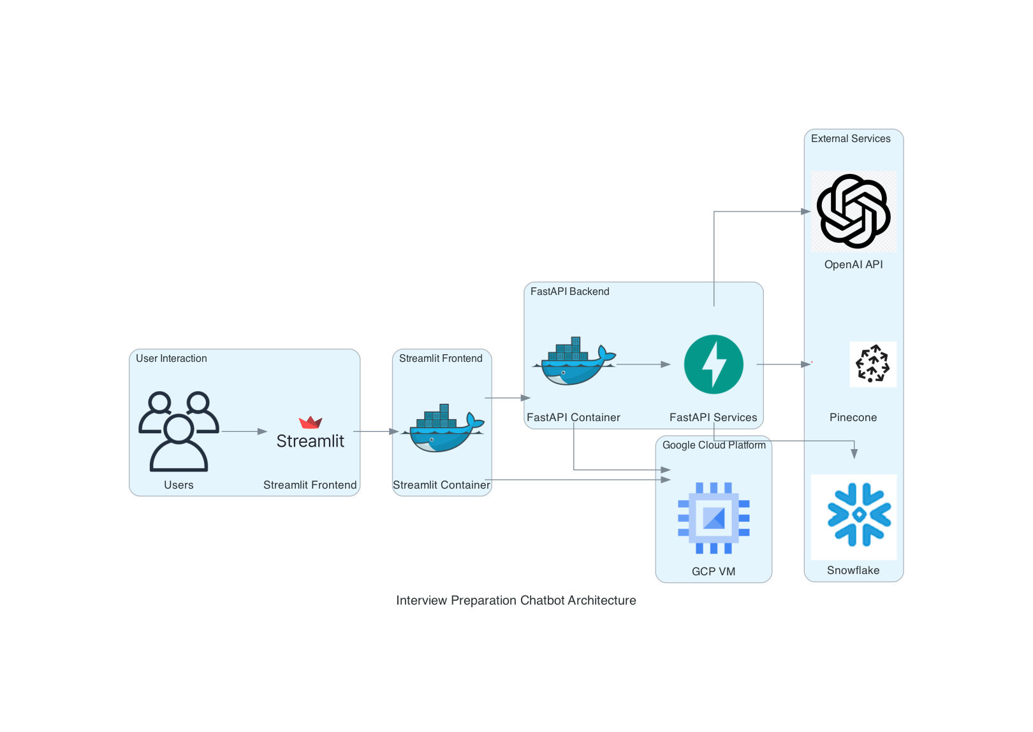




Project Architecture
User Interface
The front-end component where users interact with the chatbot.
Backend Server
Processes user inputs and manages data flow between components.
OpenAI API for NLP
Handles natural language processing tasks.
Pinecone for Vector Similarity Search
Enables efficient retrieval of relevant information.
Technologies and tools used: Streamlit, OpenAI API, Pinecone, Snowflake/MongoDB.

Slide 5
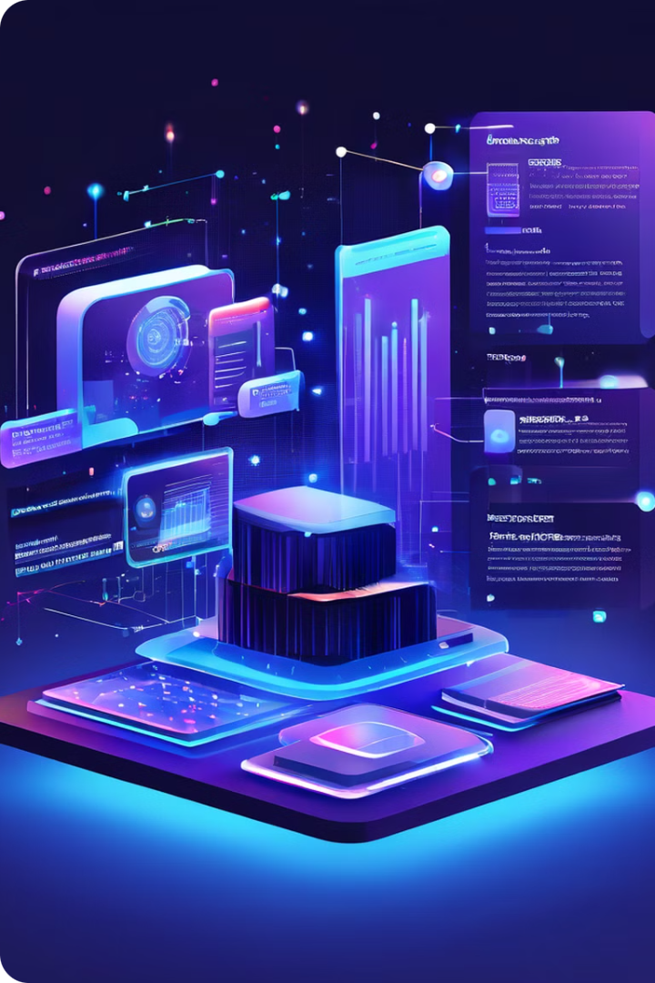
Data Collection and Preprocessing
1
Data Sources
Source and nature of the data: User inputs, resumes, online educational resources.
2
Collection Steps
Steps taken for data collection: - Resume parsing - Collecting educational content
3
Preprocessing
Data preprocessing techniques: - Text cleaning - Feature extraction

Slide 6
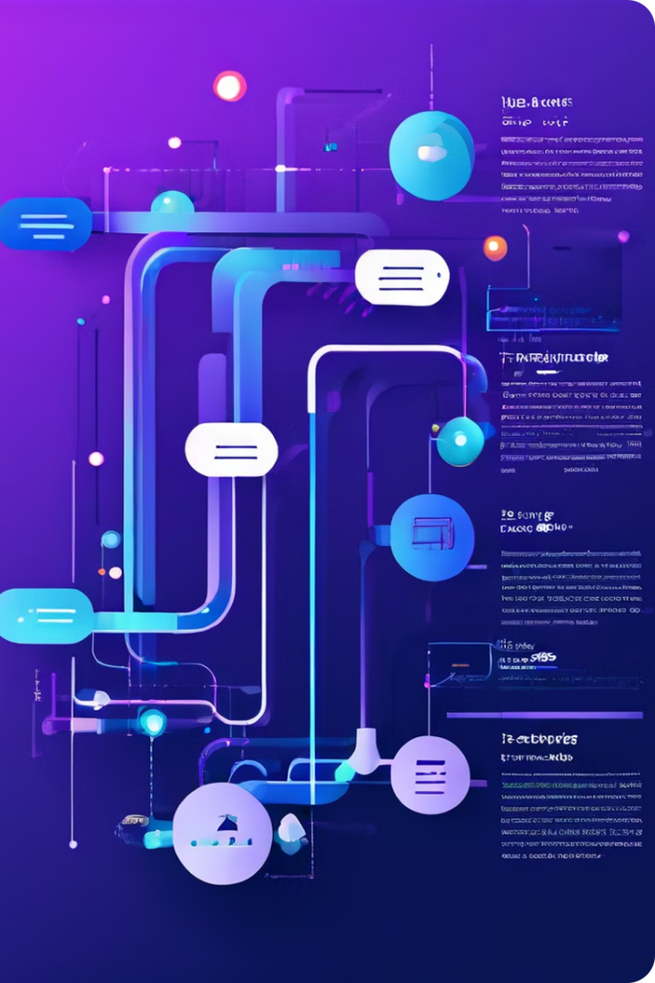
RAG Pipeline Implementation
RAG Overview
Overview of the RAG pipeline: Combining retrieval of documents with LLM generation capabilities.
Implementation Steps
Steps involved: - Indexing resources - Implementing vector search - Integrating with LLM for response generation
Challenges and Solutions
Challenges and solutions: - Handling large datasets: Implemented efficient indexing and retrieval strategies.

Slide 7
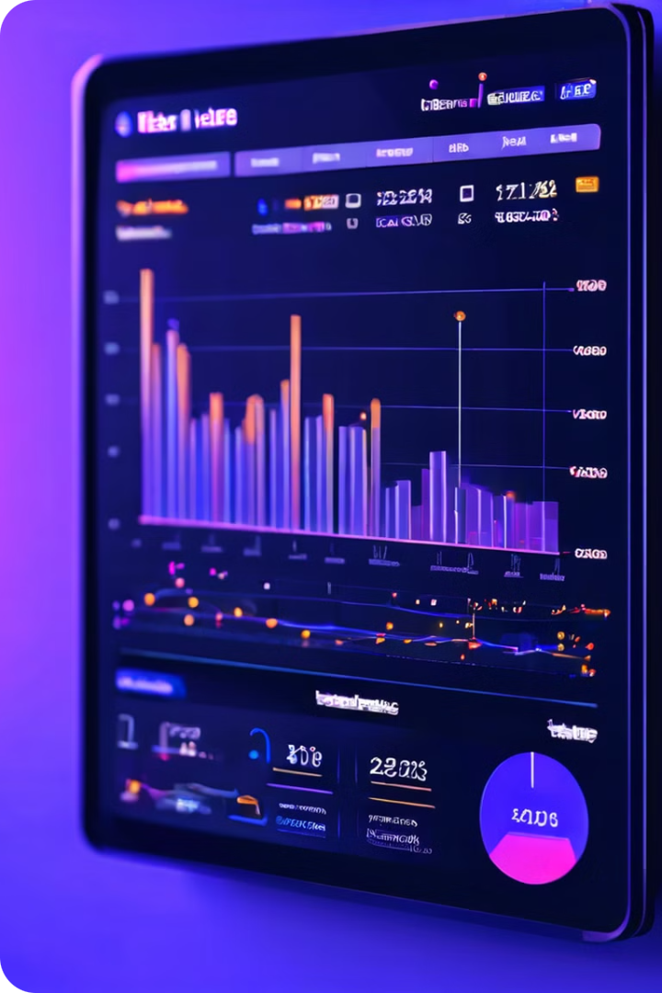
Performance Metrics
Key Metrics
Calculation Methods
Initial Results
Accuracy of recommendations
User feedback surveys
Promising feedback
User satisfaction
System usage analytics
Positive initial observations

Slide 8




Methods to Improve Metrics
Enhance Resource Database
Adding more diverse content to improve recommendations.
Refine Algorithms
Fine-tuning LLM parameters for better performance.
Expected Impact
Increased accuracy and user satisfaction.

Slide 9

Deployment Plan
1
Final Testing
Rigorous testing to ensure system reliability and performance.
2
Hosting Setup
Setting up hosting environment using GCP.
3
User Testing
Initial rollout to a select user group for feedback.

Slide 10
Future Work
Potential Extensions
Long-term Vision
Continuous Improvement
- Expanding to other domains (e.g., technical skills, soft skills)
A comprehensive platform for career development.
Further development: Continuous improvement based on user feedback.

